Slide 1

ACUTE WOUNDS
Dr Manjula Peiris

Slide 2
DEFINITION
An injury to living tissue caused by a cut, blow, or other impact, typically one in which the skin is cut or broken
  Defect in covering
  Tissue loss
  Exposure of underlying tissue
  Damage to underlying tissue

Slide 3
TWO TYPES
ACUTE
CHRONIC – FAILURE OF HEALING WITHIN THE ‘PHYSIOLOGICAL’ TIME SPAN

Slide 4
ACUTE WOUNDS
SKIN
  ABRASION
  INCISION
  LACERATION
  CONTUSION
  DEGLOVING/FLAYING

Slide 5
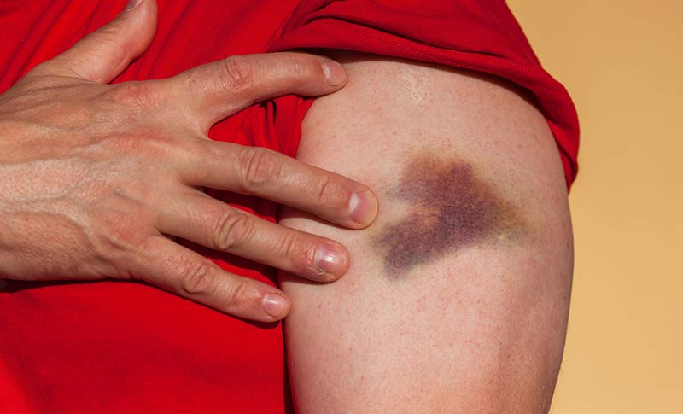

Slide 6
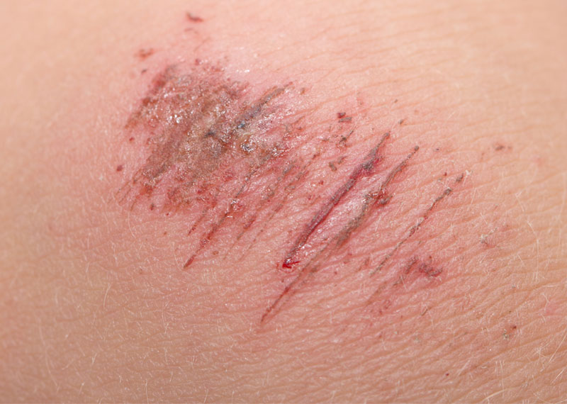

Slide 7
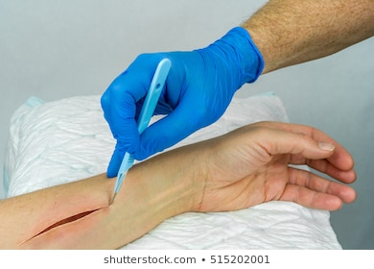

Slide 8
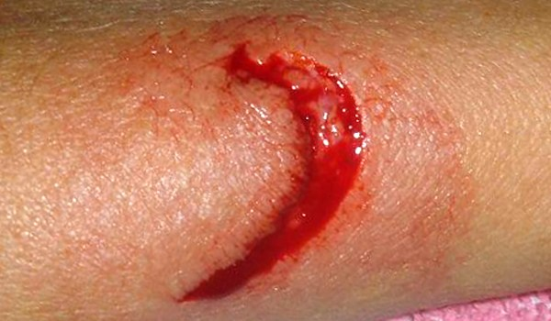

Slide 9
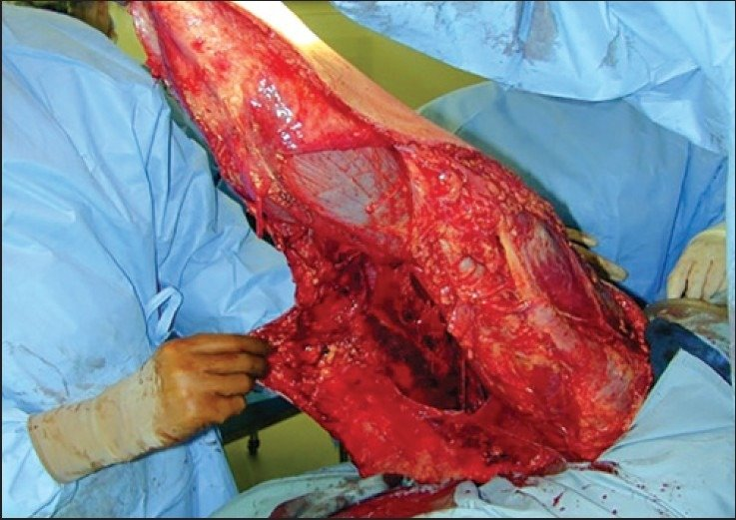

Slide 10
ISSUES
BLEEDING
PAIN
CONTAMINATION
DAMAGE TO ANATOMY

Slide 11
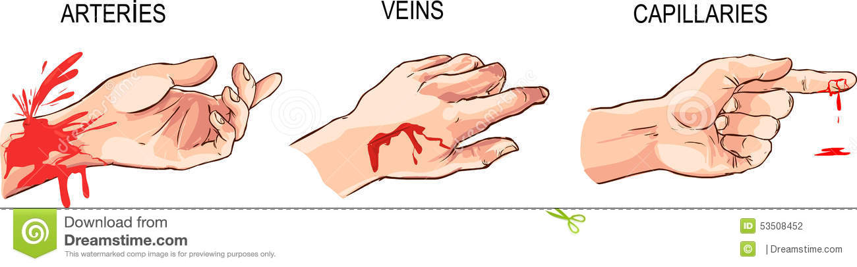
BLEEDING

Slide 12
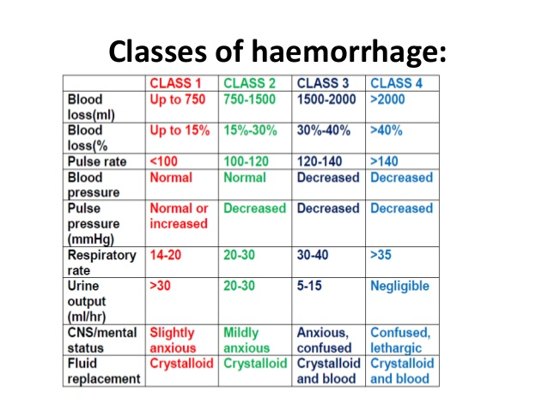
BLEEDING

Slide 13
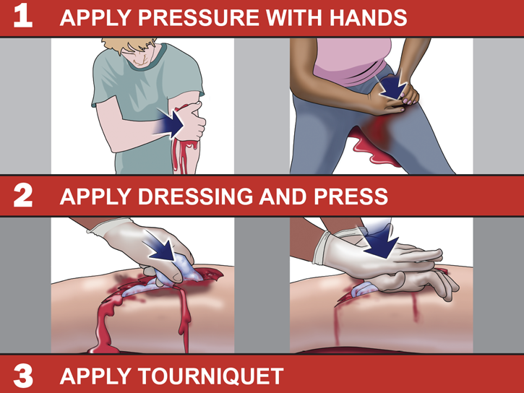

Slide 14
ASSESS
QUANTITY
TIME
DERANGEMENT OF COAGULATION

Slide 15
BEEDING
BLOOD ON THE ‘FLOOR’
AND ‘FOUR’ MORE
  ABDOMEN 4L
  THORAX 3L
  PELVIS 2L
  LONG BONE 1L

Slide 16
REPLACE
SALINE
COLLOIDS
BLOOD PRODUCTS
WHOLE BLOOD

Slide 17
CONTAMINATION
BACTERIA CARRYING PARTICLES
PROLIFERATION
INVASION
MINIMUM
6
HOURS

Slide 18
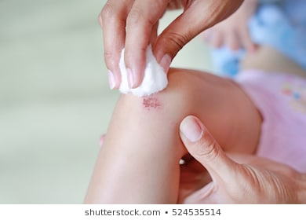
DECONTAMINATION

Slide 19
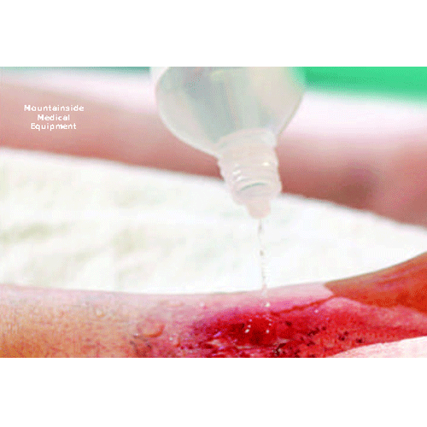

Slide 20
PAIN
PAIN CONTROL LADDER
  SIMPLE ANALGESIA
  NSAIDS
  WEAK OPIOIDS
  STRONG OPIOIDS
  ANAESTHETICS
SEDATIVES
ANXIOLYTICS, ETC

Slide 21
LOSS OF TISSUE
NERVES
BLOOD VESSELS
ORGANS
SOFT TISSUE
MUSCLE
BONE AND JOINTS

Slide 22
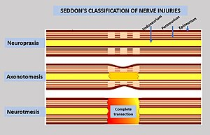

Slide 23
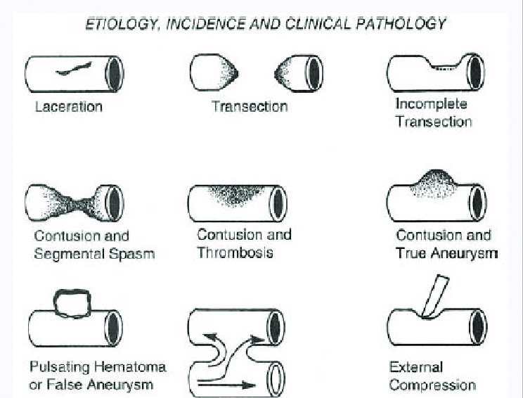

Slide 24
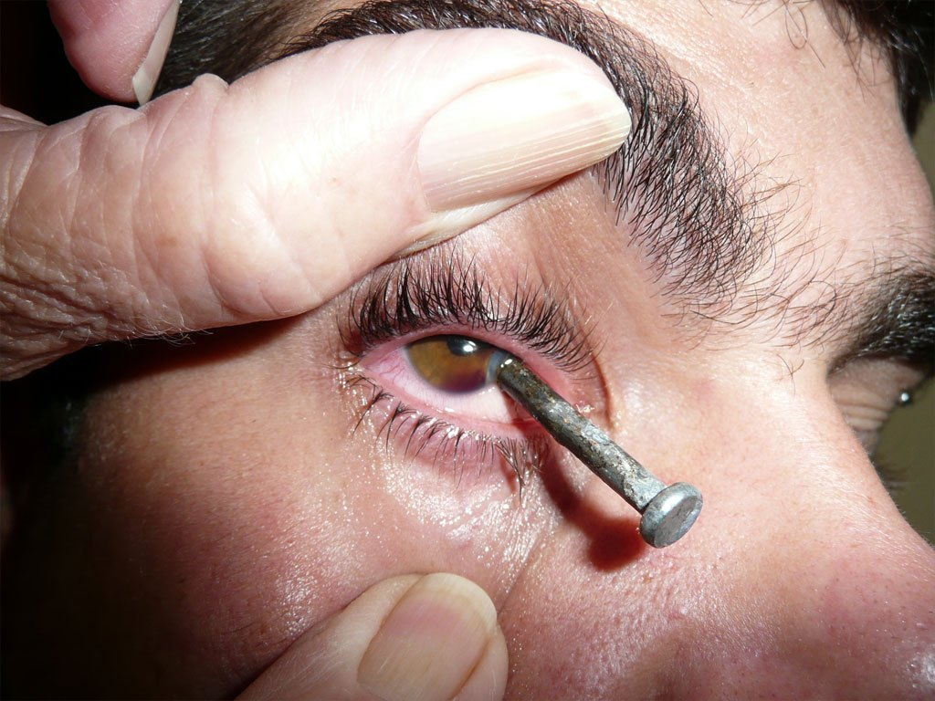

Slide 25
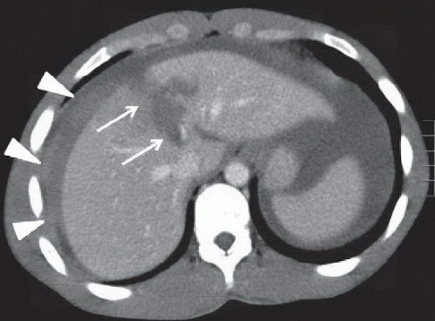

Slide 26
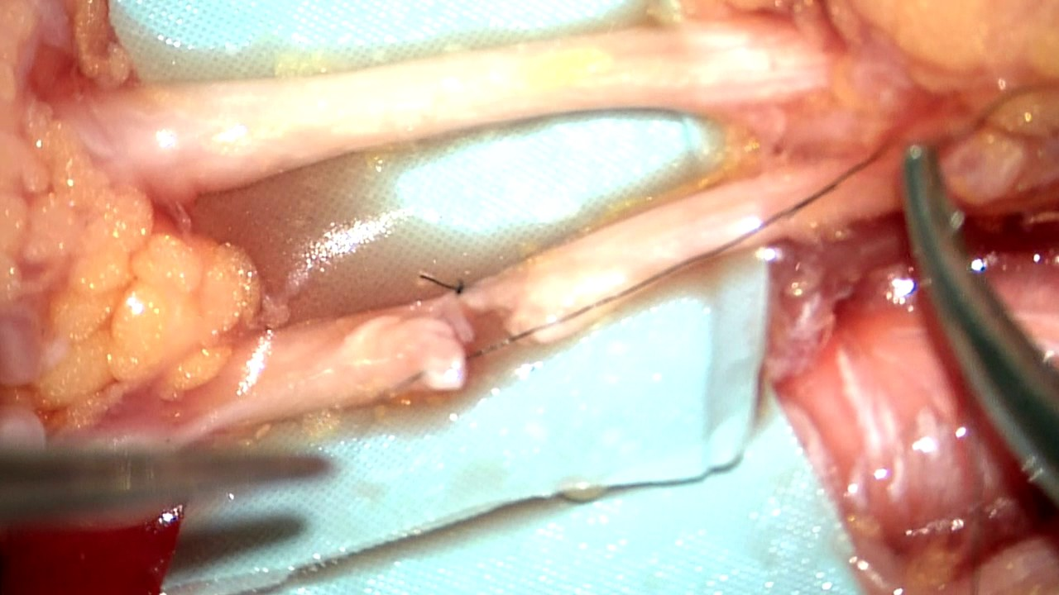

Slide 27
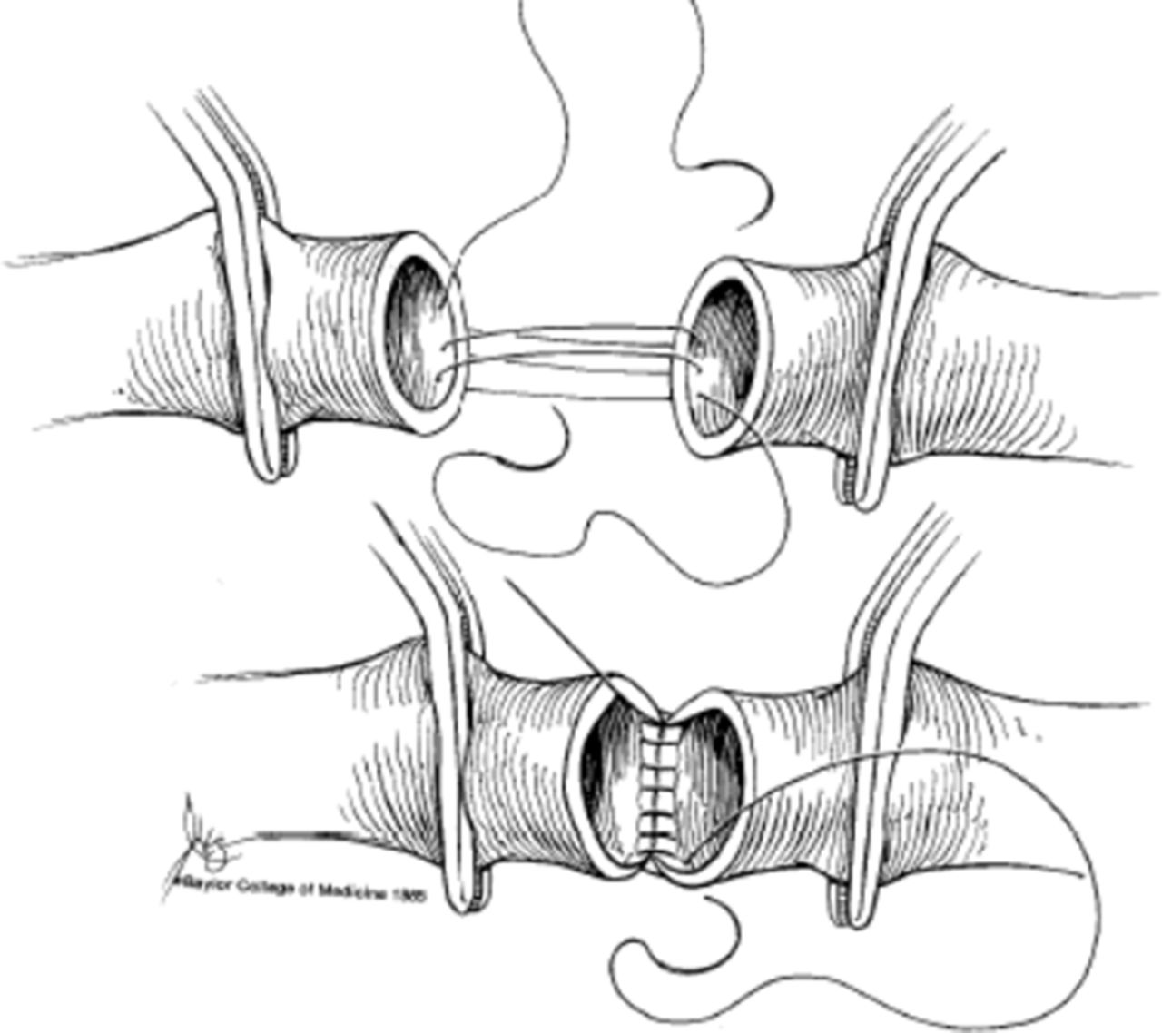

Slide 28
WOUND CLOSURE
SIMPLE APPROXIMATION
FLAPS
GRAFTS
FREE FLAPS
TRANSPLANT

Slide 29
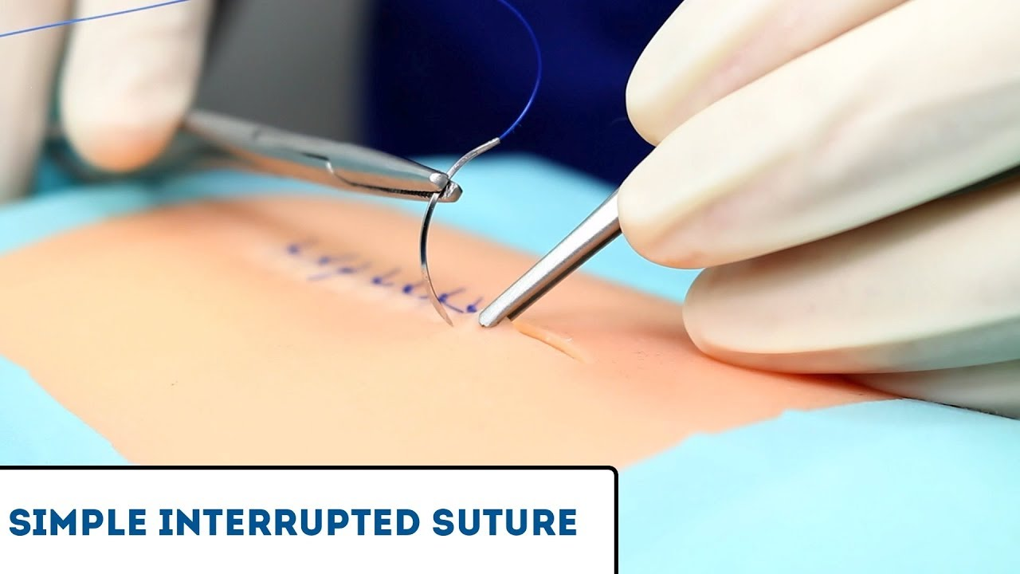

Slide 30
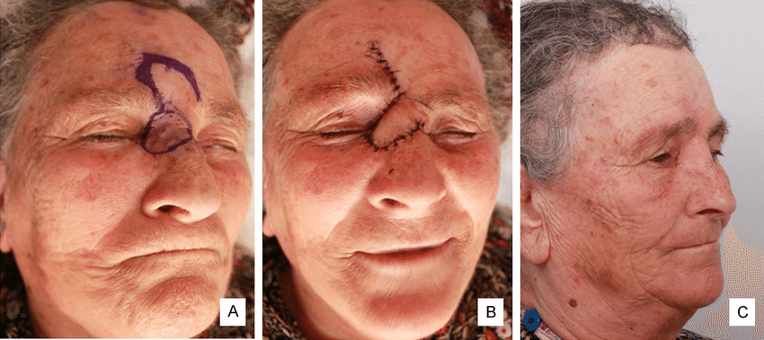

Slide 31
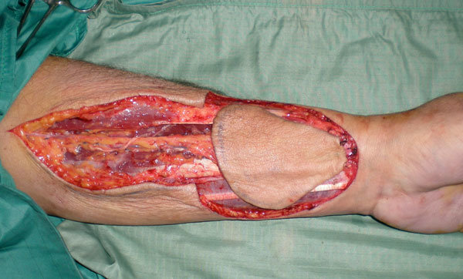

Slide 32
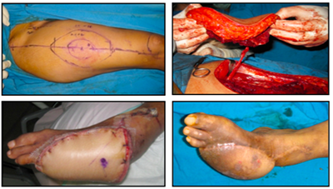

Slide 33
MANAGEMENT OF AN ACUTE WOUND
ASSESS
  BLEEDING
  PAIN
  CONTAMINATION
  TISSUE LOSS
TREAT
  SURGICAL
    DEBRIDE/CLEAN/TOILET
    RECONSTRUCT
  MEDICAL
  SUPPORTIVE

